Slide 1


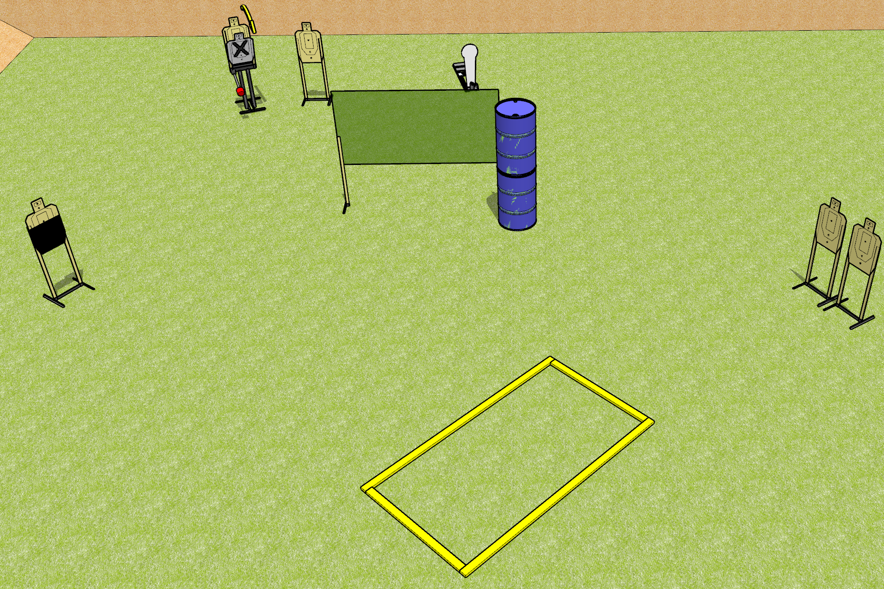
 | Dothan Gun Club – USPSA Match Easy Peasy Course Designer : Drew Coleman
Round Count 11 Rounds 5 USPSA 1 Colt popper
Equipment List 2 wall feet 2 medium fault lines + 2 10 ft fault lines Max trap + activator 1 50% HC

Slide 2
Easy Peasy
Written Stage Briefing
Easy Peasy is an 11 round, 55 point, Comstock course of fire. There are 5 USPSA targets and 1 colt popper. The best 2 hits on paper will score, and steel must fall to score. The start signal is audible.
The max trap is activated by the colt popper, and must be activated before being engaged. It is visible at rest.
Handgun start position is outside the shooting area, wrists below belt. Handgun is loaded and holstered,
PCC start position is outside the shooting area, stock on belt. Carbine is loaded with safety on.
On start signal engage targets as they become available from within the shooting area.

